Slide 1
Unbiasedness(contd…)
Session 4
12/03/2021

Slide 2
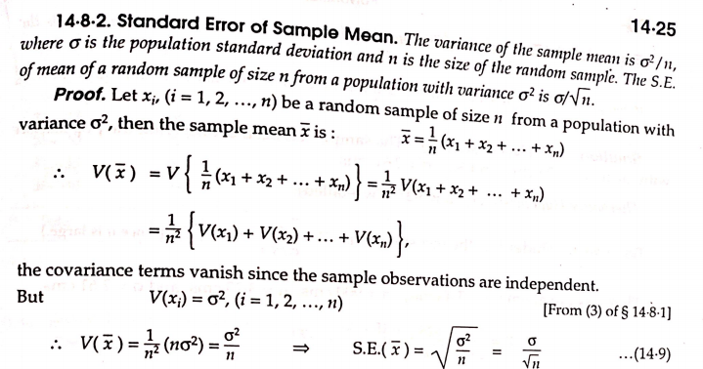
Standard Error of sample mean

Slide 3

Remark
If E(t_{n})>θ, t_{n} is said to be positively biased and if E(t_{n})<θ, is said to be negatively biased.
The amount of bias b(θ) is given by E(t_{n})- θ, $θ∈Θ$

Slide 4
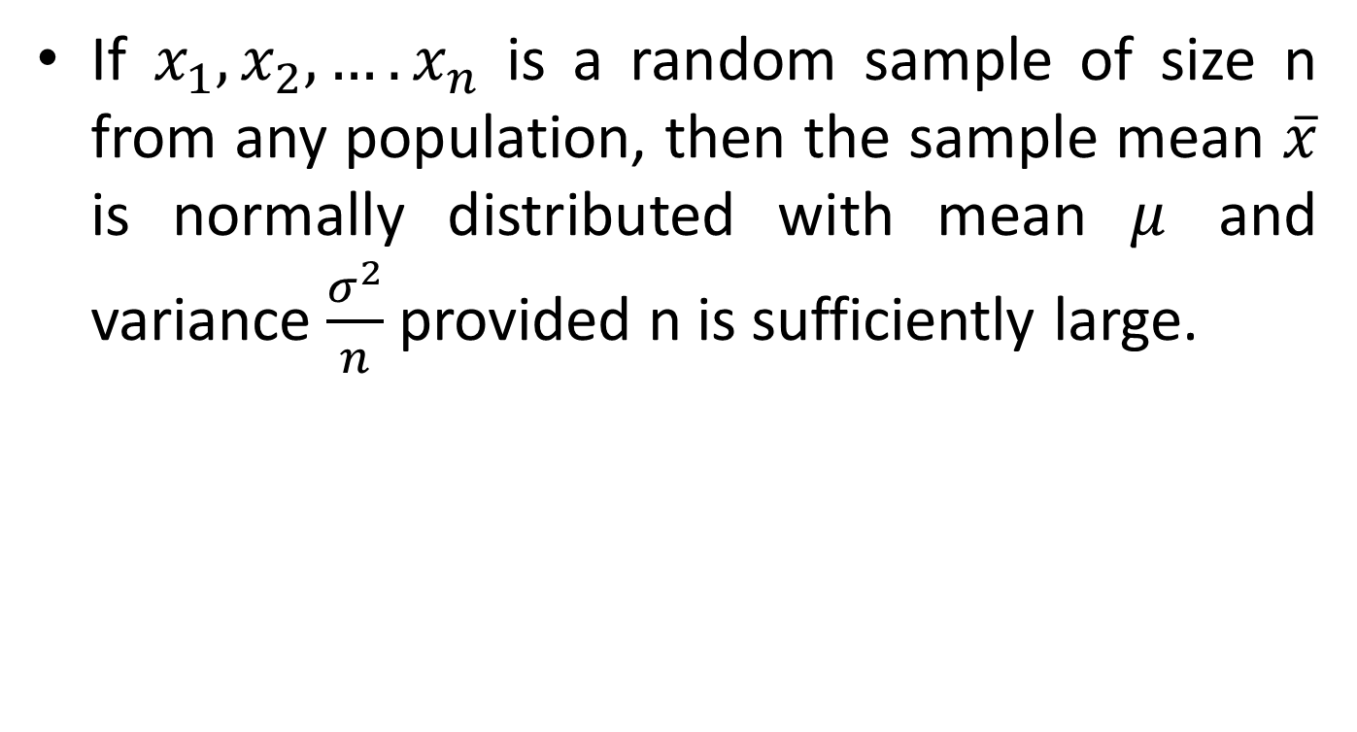
Central Limit Theorem
If $x_{1},x_{2},….x_{n}$ is a random sample of size n from any population, then the sample mean $\overline{x}$ is normally distributed with mean $μ$ and variance $\frac{σ^{2}}{n}$ provided n is sufficiently large.

Slide 5
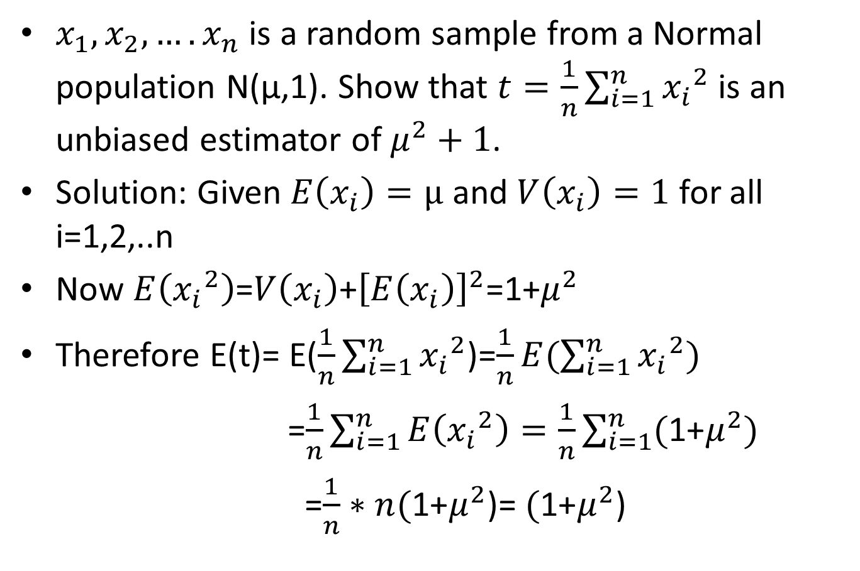
Example 1
$x_{1},x_{2},….x_{n}$ is a random sample from a Normal population N(μ,1). Show that $t=\frac{1}{n}\sum_{i=1}^{n}{{x_{i}}^{2}}$ is an unbiased estimator of $μ^{2}+1$.
Solution: Given $E\left(x_{i}\right)=μ$ and $V\left(x_{i}\right)=1$ for all i=1,2,..n
Now $E\left({x_{i}}^{2}\right)$=$V\left(x_{i}\right)$+${\left[E\left(x_{i}\right)\right]}^{2}$=1+$μ^{2}$
Therefore E(t)= E($\frac{1}{n}\sum_{i=1}^{n}{{x_{i}}^{2}}$)=$\frac{1}{n}E(\sum_{i=1}^{n}{{x_{i}}^{2})}$
=$\frac{1}{n}\sum_{i=1}^{n}{E\left({x_{i}}^{2}\right)}=\frac{1}{n}\sum_{i=1}^{n}{(\text{1+}μ^{2})}$
=$\frac{1}{n}∗n(\text{1+}μ^{2}$)= $(\text{1+}μ^{2}$)

Slide 6
Example 2&3(refer lecture notes)

